Slide 1

Dangerous Pickles
20th October, Dmitry Denisov

Slide 2


Myself
Work as Data Scientist in Careem (Fraud department)
Before: Data Scientist in Deloitte
Interested in Education sphere:
- Conducted a Deep Learning course https://www.coursera.org/learn/intro-to-deep-learning
- Course for Open Data Science community: https://bit.ly/3csuc0g
- Data Science course in Saudi Arabia in Sept-Oct 2021
Background: Data Science/Math, Bachelor’s in Applied Math and Masters in Data Science

Slide 3

Sources inspired me for this talk
https://github.com/mike0sv/nasty_pickle
https://intoli.com/blog/dangerous-pickles/
(RUS) https://www.youtube.com/watch?v=xm-A-h9QkXg&t=610s&ab_channel=ODSAIGlobal

Slide 4
Russians hackers
What is associated with Rus programmer?

Slide 5
How to run virus in Python using pickle
Our today’s topic is…

Slide 6
This presentation is to show you how and why pickle can be dangerous and give you
Disclaimer

Slide 7
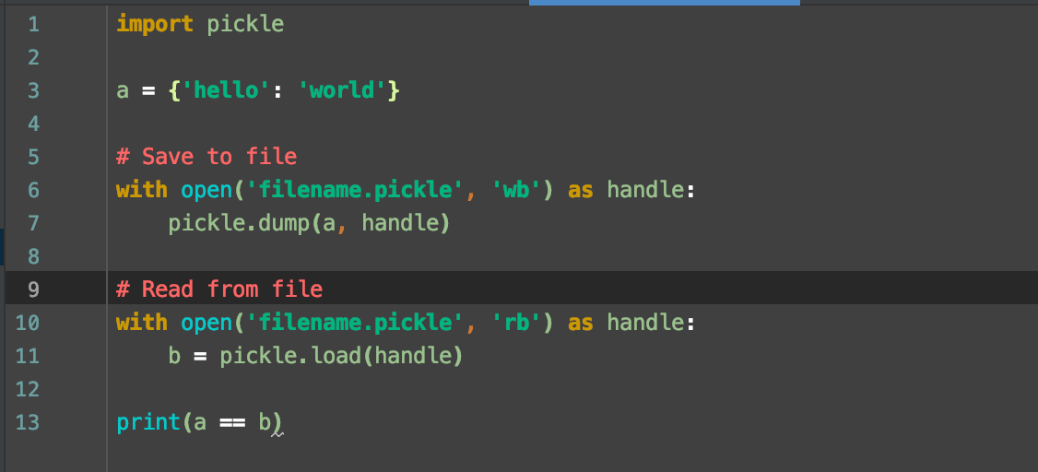
What is pickle?

Slide 8

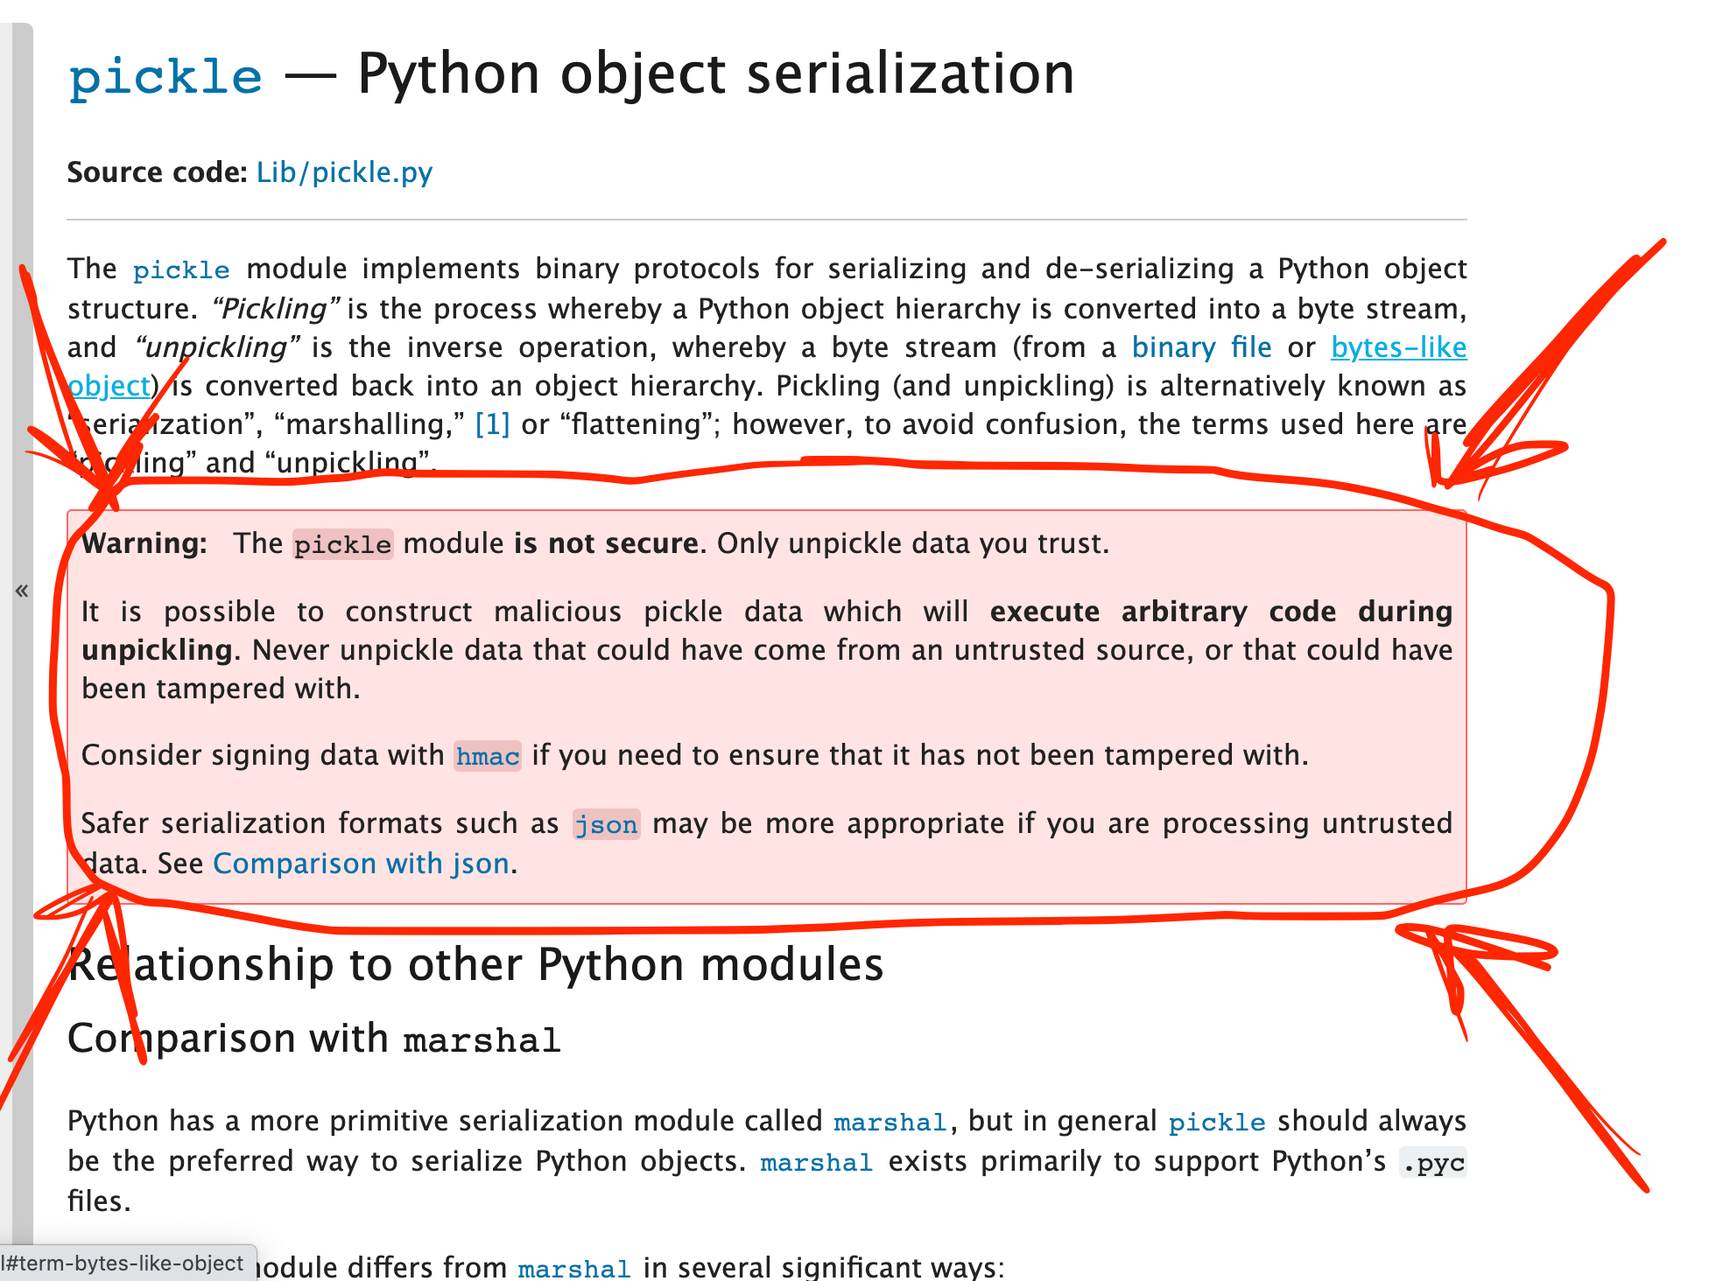
Meanwhile: pickle documentation
Execute arbitrary code during unpickling

Slide 9
Pickletools
Pickle is a stack language
push data onto the stack
pop data from the stack
Useful functions:
pickletools.optimize: removes technical details from pickle
pickletools.dis: prints all pickle commands

Slide 10
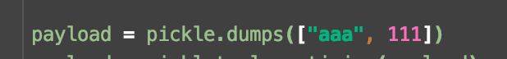
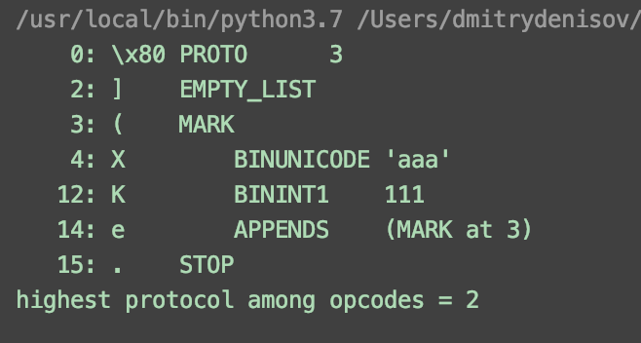
Pickling machine + Opscodes example
pickletools.optimize + pickletools.dis
Protocol version
Put into stack: empty list
Put into stack Mark
Put into stack: ’aaa’
Put into stack: 111
Take all from stack until Mark
Stop

Slide 11
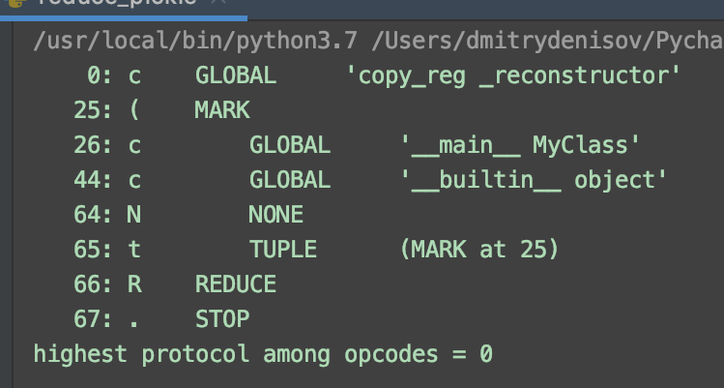
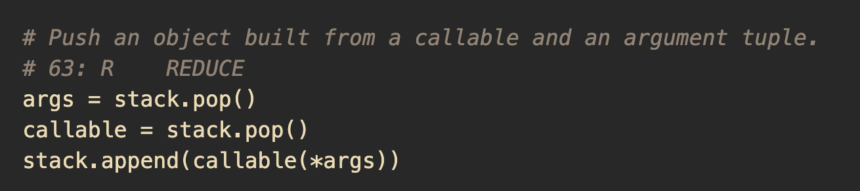
Opscodes example: REDUCE function
We call function that we just imported!

Slide 12
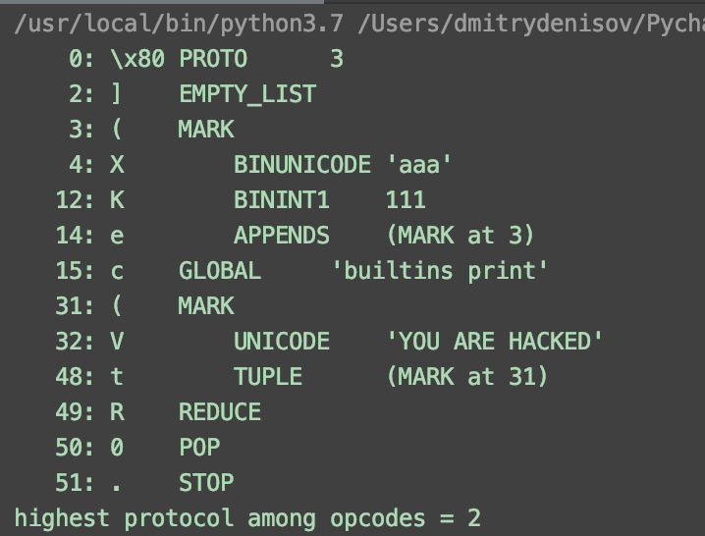
My first pickle bomb - add bytes to our pickled file
Before:
After:

Slide 13
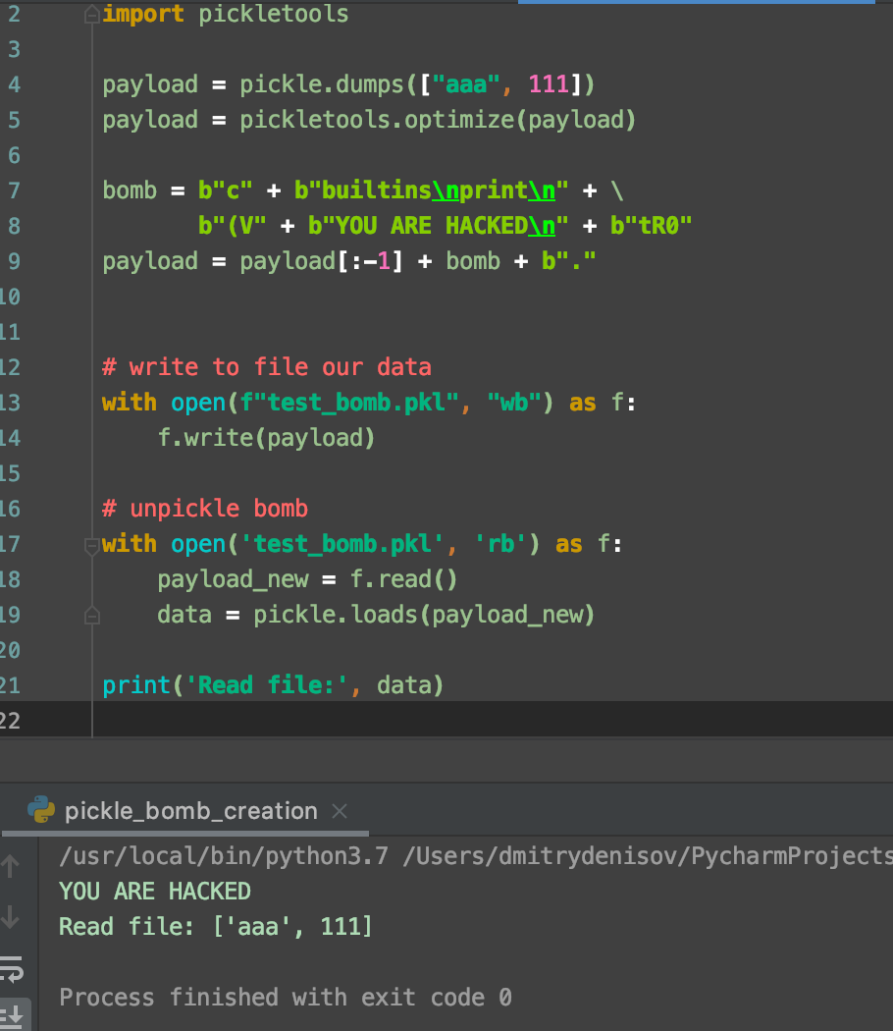


We are done, our first bomb is ready

Slide 14
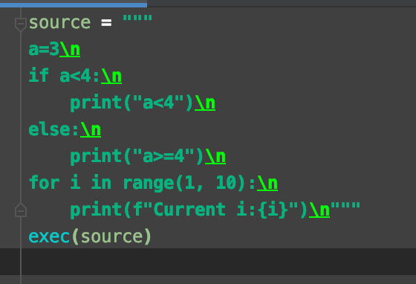
Arbitrary function
So far we managed to do only print
exec function will help us to execute arbitrary code

Slide 15
Final recipe
Import exec function
Push to pickle stack loooong string of code
Write directly REDUCE method into pickle

Slide 16
Repo + QR code
https://github.com/DmitriiDenisov/nasty_pickle

Slide 17
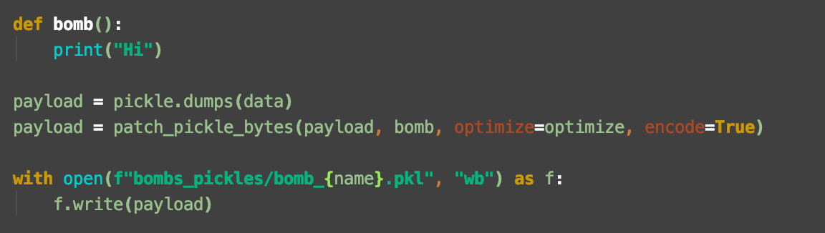
Code for patching a bomb
Assume we want to call arbitrary function: bomb_function

Slide 18
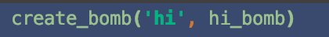
Now we wrapped everything into function: create_bomb

Slide 19
Short demos of possible injections:
Hi bomb
Raise exception bomb
Open URL bomb
Open image bomb
If + try-except + for loop
Swap integers

Slide 20
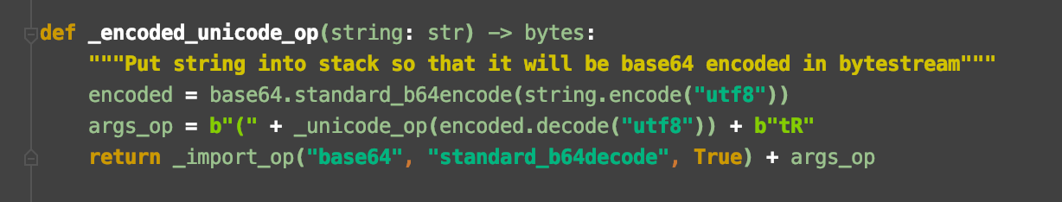
Encode the bomb
How we can be hackers if we don’t encode our bomb?
base64 encoding
Before unpickle we decode it back

Slide 21
Virus – put bomb in every next pickle
Finally, how we can call it a virus, if it does not spread??
Demo of:
1. Hi bomb
2. Open URL bomb

Slide 22

Questions?
GitHub: https://github.com/DmitriiDenisov
LindedIn: https://www.linkedin.com/in/dmitry-denisov-022102103/
Web: https://ddenisov.com/

